Slide 1

NATIONAL UNIVERSITY OF MODERN LANGUAGES
Faculty of Engineering and Computing
Department of Software Engineering

Slide 2
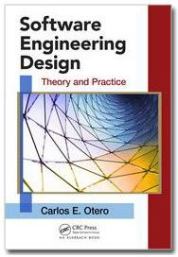
SOFTWARE DESIGN AND ARCHITECTURE
LECTURE NO. 12
Introduction to Software Engineering Design
Course Instructor: | Mr. Ahsan Arif
 | Lecturer Department of Software Engineering NUML Islamabad
Date: May 20, 2024
Software Engineering Design: Theory and Practice

Slide 3
LECTURE CONTENTS
  Human-Computer Interface Design
    What Is Human–Computer Interface Design?
    Why Study Human–Computer Interface Design?
    General HCI Design Principles
    HCI Design Generation
    HCI design Continuation
Date: May 20, 2024
Software Engineering Design: Theory and Practice

Slide 4
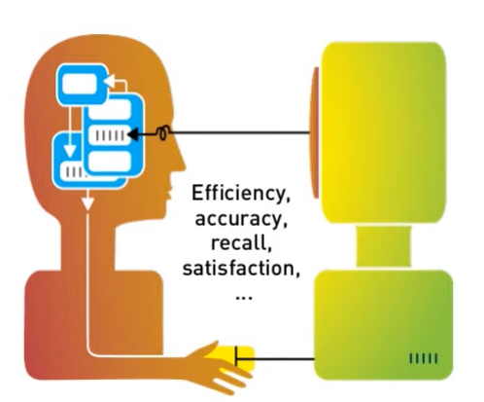
HUMAN-COMPUTER INTERFACE DESIGN
What Is Human–Computer Interface Design?
Human-Computer Interface Design, also known as Human-Computer Interaction (HCI) design, is the process of creating interfaces that allow efficient and intuitive interaction between humans and computers.
Human-Computer Interface (HCI) focused on the design, development, and study of the interaction between humans (users) and computers. The goal is to create user-friendly interfaces that improve the usability and functionality of computer systems.
Date: May 20, 2024
Software Engineering Design: Theory and Practice

Slide 5

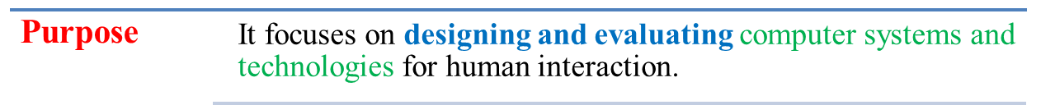
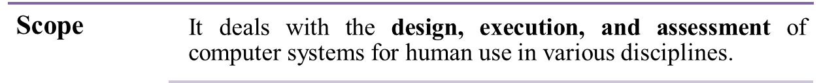
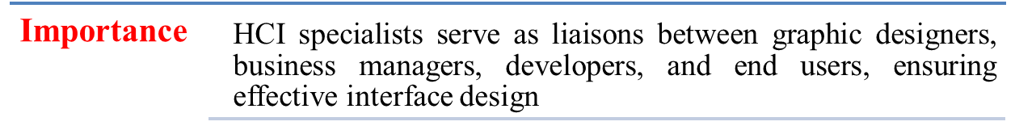
HUMAN-COMPUTER INTERFACE DESIGN
Date: May 20, 2024
Software Engineering Design: Theory and Practice

Slide 6
HUMAN-COMPUTER INTERFACE DESIGN
Why Study Human–Computer Interface Design?
Importance of Human-Computer Interface (HCI) design:
System users often judge a system by its interface rather than its functionality.
  User interfaces should be designed to match the skills, experience and expectations of its anticipated users.
A poorly designed interface can cause a user to make catastrophic errors.
  A poor UI is often a reason why so many software systems are never used.
Date: May 20, 2024
Software Engineering Design: Theory and Practice

Slide 7
HUMAN-COMPUTER INTERFACE DESIGN
There are many reasons to delve into HCI design:
Improved User Experience (UX)
Understanding HCI principles helps create interfaces that are intuitive and frustration-free, leading to happier and more productive users.
Increased Technology Adoption
Well-designed interfaces make technology more accessible, encouraging wider adoption and maximizing its potential benefits.
Enhanced Business Value
By ensuring users can easily interact with a product or service, HCI design can significantly boost sales, customer satisfaction, and brand loyalty.
Date: May 20, 2024
Software Engineering Design: Theory and Practice

Slide 8
HUMAN-COMPUTER INTERFACE DESIGN
General HCI Design Principles
Outline…
Revisit Usability Heuristics
Heuristic Evaluation
User Centered Design
Date: May 20, 2024
Software Engineering Design: Theory and Practice

Slide 9
HUMAN-COMPUTER INTERFACE DESIGN
Revisit Usability Heuristics
Usability Heuristics (“Guidelines”)
What are they?
Rules that distill principles of effective UIs
Usually, but not always correct
  Recognizing when to follow/ignore takes practice/experience
Help designers choose design alternatives
Help evaluators find problems in interfaces (“heuristic evaluation”) Plenty to choose from
Learnability
Efficiency
Safety
Date: May 20, 2024
Software Engineering Design: Theory and Practice
Notes:
To understand the technique, we should start by defining what we mean by a usability heuristic or guideline. Heuristics, or usability guidelines, are rules that distill out the principles of effective user interfaces. There are plenty of sets of guidelines to choose from - sometimes it seems like every usability researcher has their own set of heuristics. Most of these guidelines overlap in important ways, however. The experts don't disagree about what constitutes good UI. They just disagree about how to organize what we know into a small set of operational rules.
Heuristics can be used in two ways: during design, to help you choose among alternative designs; and during heuristic evaluation, to find and justify problems in interfaces.

Slide 10
HUMAN-COMPUTER INTERFACE DESIGN
Revisit Usability Heuristics
Nielsen’s 10 principles
Norman’s rules from Design of Everyday Things
Tognazzini’s 16 principles
Shneiderman’s 8 golden rules
Same general ideas, organized differently
Date: May 20, 2024
Software Engineering Design: Theory and Practice
Notes:
To understand the technique, we should start by defining what we mean by a usability heuristic or guideline. Heuristics, or usability guidelines, are rules that distill out the principles of effective user interfaces. There are plenty of sets of guidelines to choose from - sometimes it seems like every usability researcher has their own set of heuristics. Most of these guidelines overlap in important ways, however. The experts don't disagree about what constitutes good UI. They just disagree about how to organize what we know into a small set of operational rules.
Heuristics can be used in two ways: during design, to help you choose among alternative designs; and during heuristic evaluation, to find and justify problems in interfaces.

Slide 11
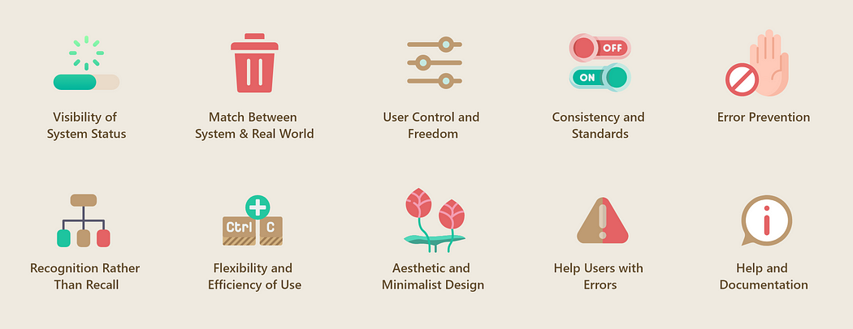
Nielsen’s 10 principles…
What is Usability heuristics?
Usability heuristics are a set of general guidelines or rules of thumb that designers and usability experts follow to evaluate and improve the user-friendliness and overall usability of a product, such as a website or an application.
Date: May 20, 2024
Software Engineering Design: Theory and Practice
Notes:
The 10 heuristics defined by Jakob Nielsen and Rolf Molich are good practices that can be applied to interface design to evaluate its usability.
These are principles based on the observation of real users and the problems they face when using any type of interface.
They are generic guidelines which have been used for many years (the first version is from 1989 and the latest update from 2005) but, even so, they continue to be a valid instrument to detect usability problems today.

Slide 12
Nielsen’s 10 principles…
Match the real world (L)
Consistency & standards (L)
Help and documentation (L)
Learnability
User control and freedom (S)
Visibility of system status (S)
Efficiency
Flexibility and efficiency (E)
Error prevention (S)
Safety
Recognition, not recall (S)
Error reporting, diagnosis, and recovery (S)
Aesthetic and minimalist design
Date: May 20, 2024
Software Engineering Design: Theory and Practice

Slide 13
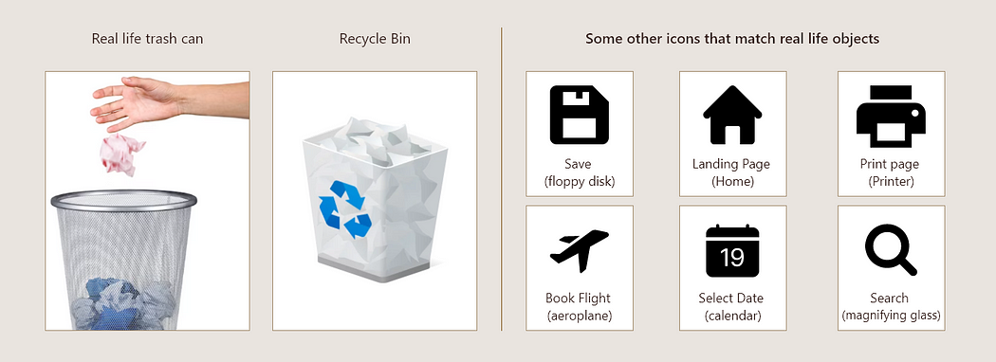
Match Between the System and the Real World (L)
Interfaces should communicate with users through concepts and phrases that are familiar to them. As such, designs should align with the users’ everyday language and experiences, avoiding internal jargon and unfamiliar terminology.
For example, navigation menus should use labels like “About Us” and “Blog” that people already know and understand.
Resemblance of real life objects in icons
Date: May 20, 2024
Software Engineering Design: Theory and Practice
Notes:
Jakob Nielsen, who invented the technique we're talking about, has 10 heuristics. (An older version of the same heuristics, with different names but similar content, can be found in his Usability Engineering book, one of the recommended books for designerss.)
We've talked about all of these in previous design principles reading (the particular reading is marked by a letter, e.g. L for Learnability).

Slide 14
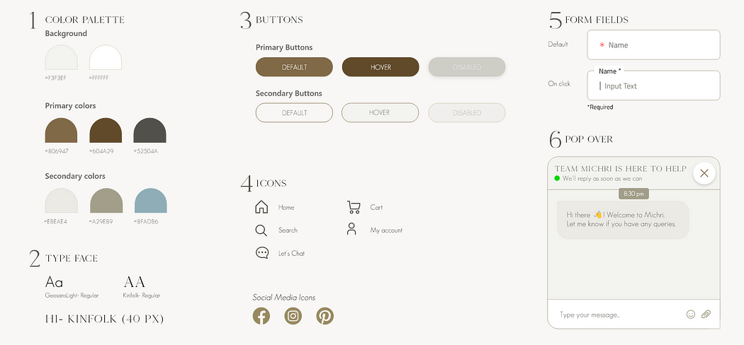
Consistency & standards (L)
Follow consistent conventions and design patterns throughout your interface, like using the same button styles and colors for similar actions.
Following a style guide is a good practice to maintain consistency
Date: May 20, 2024
Software Engineering Design: Theory and Practice
Notes:
Jakob Nielsen, who invented the technique we're talking about, has 10 heuristics. (An older version of the same heuristics, with different names but similar content, can be found in his Usability Engineering book, one of the recommended books for designerss.)
We've talked about all of these in previous design principles reading (the particular reading is marked by a letter, e.g. L for Learnability).

Slide 15
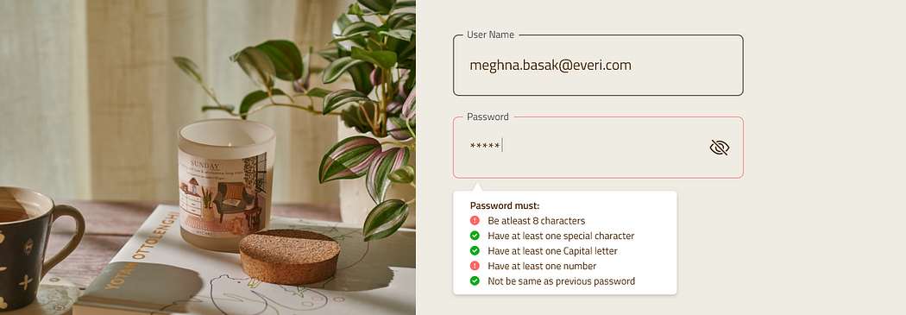
Help and documentation (L)
Ideally, systems should be designed to be as self-explanatory as possible. However, it’s often necessary to provide additional documentation to help users who require guidance or run into problems, especially with more complex software programs.
Effective tooltip design gives clarity and context to users
Date: May 20, 2024
Software Engineering Design: Theory and Practice
Notes:
Jakob Nielsen, who invented the technique we're talking about, has 10 heuristics. (An older version of the same heuristics, with different names but similar content, can be found in his Usability Engineering book, one of the recommended books for designerss.)
We've talked about all of these in previous design principles reading (the particular reading is marked by a letter, e.g. L for Learnability).

Slide 16
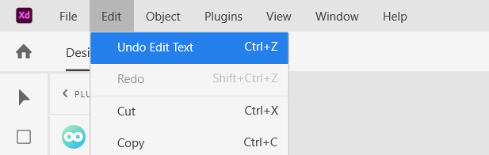
User control & freedom (S)
Allow users to easily navigate and exit situations, such as providing a “Cancel” or “Go Back” option during a multi-step process.
Undo and Redo gives flexibility to users
Date: May 20, 2024
Software Engineering Design: Theory and Practice
Notes:
Jakob Nielsen, who invented the technique we're talking about, has 10 heuristics. (An older version of the same heuristics, with different names but similar content, can be found in his Usability Engineering book, one of the recommended books for designerss.)
We've talked about all of these in previous design principles reading (the particular reading is marked by a letter, e.g. L for Learnability).

Slide 17

Visibility of system status (S)
Keep users informed about what’s happening through appropriate feedback within a reasonable time. For example, show loading indicators during data processing.
Progress bar indicating status
Date: May 20, 2024
Software Engineering Design: Theory and Practice
Notes:
Jakob Nielsen, who invented the technique we're talking about, has 10 heuristics. (An older version of the same heuristics, with different names but similar content, can be found in his Usability Engineering book, one of the recommended books for designerss.)
We've talked about all of these in previous design principles reading (the particular reading is marked by a letter, e.g. L for Learnability).

Slide 18
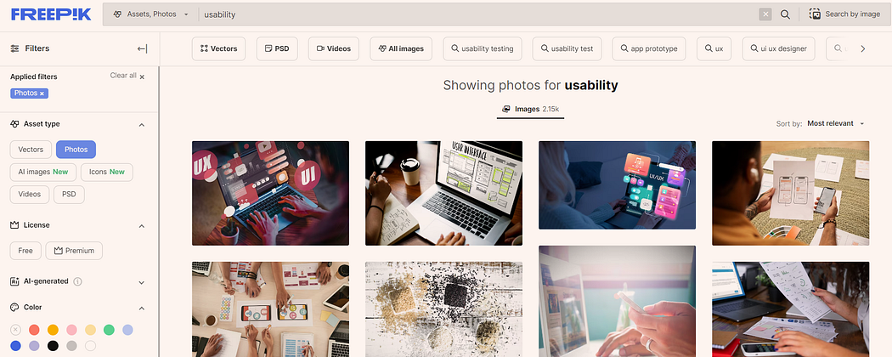
Flexibility and efficiency (E)
Cater to both novice and expert users. Offer shortcuts and advanced features for experienced users while keeping basic functions simple for beginners.
New users can search for images, expert users can use filters for favorable results
Date: May 20, 2024
Software Engineering Design: Theory and Practice
Notes:
Jakob Nielsen, who invented the technique we're talking about, has 10 heuristics. (An older version of the same heuristics, with different names but similar content, can be found in his Usability Engineering book, one of the recommended books for designerss.)
We've talked about all of these in previous design principles reading (the particular reading is marked by a letter, e.g. L for Learnability).

Slide 19
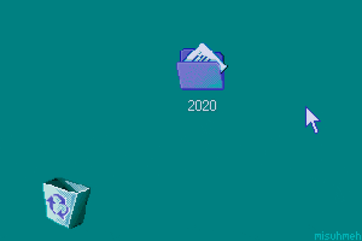
Error prevention (S)
Implement safeguards to prevent errors, such as confirmation dialogs before critical actions like deleting data.
Confirmation messages can prevent unwanted mistakes by user
Date: May 20, 2024
Software Engineering Design: Theory and Practice
Notes:
Jakob Nielsen, who invented the technique we're talking about, has 10 heuristics. (An older version of the same heuristics, with different names but similar content, can be found in his Usability Engineering book, one of the recommended books for designerss.)
We've talked about all of these in previous design principles reading (the particular reading is marked by a letter, e.g. L for Learnability).

Slide 20

Recognition, not recall (S)
Make information, options, and actions visible and easily accessible. Avoid relying on users’ memory, and provide labels and cues where needed.
Google Suggest is designed to help users find relevant search queries more quickly
Date: May 20, 2024
Software Engineering Design: Theory and Practice
Notes:
Jakob Nielsen, who invented the technique we're talking about, has 10 heuristics. (An older version of the same heuristics, with different names but similar content, can be found in his Usability Engineering book, one of the recommended books for designerss.)
We've talked about all of these in previous design principles reading (the particular reading is marked by a letter, e.g. L for Learnability).

Slide 21
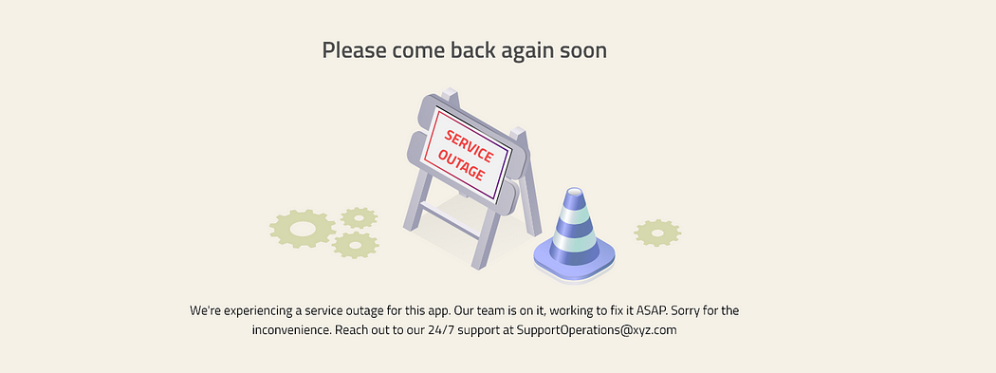
Error reporting, diagnosis, and recovery (S)
Clearly communicate error messages, their causes, and provide guidance on how to recover from them.
Explanative error messages can improve user retention
Date: May 20, 2024
Software Engineering Design: Theory and Practice
Notes:
Jakob Nielsen, who invented the technique we're talking about, has 10 heuristics. (An older version of the same heuristics, with different names but similar content, can be found in his Usability Engineering book, one of the recommended books for designerss.)
We've talked about all of these in previous design principles reading (the particular reading is marked by a letter, e.g. L for Learnability).

Slide 22

Aesthetic and minimalist design
Strive for a clean and minimalist design with only essential elements to reduce cognitive load and visual clutter.
https://www.naturetherapy.co.in/ has a clean display of products that look appealing
Date: May 20, 2024
Software Engineering Design: Theory and Practice
Notes:
Jakob Nielsen, who invented the technique we're talking about, has 10 heuristics. (An older version of the same heuristics, with different names but similar content, can be found in his Usability Engineering book, one of the recommended books for designerss.)
We've talked about all of these in previous design principles reading (the particular reading is marked by a letter, e.g. L for Learnability).

Slide 23

Norman Principles
Affordances
Natural mapping
Visibility
Feedback
Tog’s First Principles
Aesthetics
Anticipation
Autonomy (control)
Color
Consistency
Defaults
Discoverability
Efficiency
Explorable interfaces
Fitts’s Law
Human interface objects
Latency reduction (feedback)
Learnability
Metaphors
Protect users’ work
Readability
Simplicity
Track state
Visible navigation
Shneiderman’s 8 Golden Rules
Consistency
Universal Usability
Feedback
Dialog closure
Prevent and repair with Errors
Reversible actions
Keep user in control
Reduce short-term memory load
Date: May 20, 2024
Software Engineering Design: Theory and Practice
Notes:
We've also talked about some design guidelines proposed by Don Norman: visibility, affordances, natural mapping, and feedback (all in the Learnability reading).
Finally we have Shneiderman's 8 Golden Rules of UI design, which include most of the principles we've already discussed.
Another good list is Tog's First Principles, 16 principles from Bruce Tognazzini. We've seen most of these in previous readings. Here are the ones we haven't discussed (as such):
Autonomy: user is in control.
Human interface objects: another way of saying direct manipulation: onscreen objects should be continuously perceivable, and manipulable by physical actions.
Latency reduction: minimize response time and give appropriate feedback for slow operations.

Slide 24
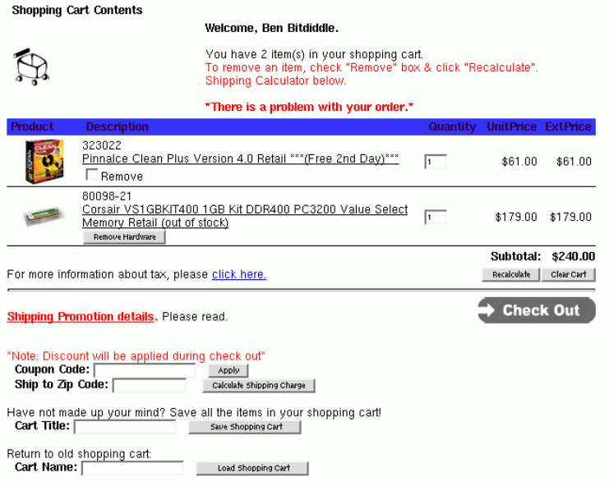
Example…
Nielsen Heuristics
Match the real world (L)
Consistency & standards (L)
Help & documentation (L)
User control & freedom (S)
Visibility of system status (S)
Flexibility & efficiency (E)
Error prevention (S)
Recognition, not recall (S)
Error reporting, diagnosis, and recovery (S)
Aesthetic & minimalist design
Date: May 20, 2024
Software Engineering Design: Theory and Practice
Notes:
Jakob Nielsen, who invented the technique we're talking about, has 10 heuristics. (An older version of the same heuristics, with different names but similar content, can be found in his Usability Engineering book, one of the recommended books for designerss.)
We've talked about all of these in previous design principles reading (the particular reading is marked by a letter, e.g. L for Learnability).

Slide 25
Solution…
Here are two of the heuristics mentioned in the image that could be relevant to the error message:
Match the real world: This heuristic suggests that interfaces should use terms and concepts that are familiar to users in their everyday world.
  For example, an error message could say “We couldn’t find an item in your cart” instead of “There is a problem with your order.”
Visibility of system status: This heuristic suggests that interfaces should keep users informed about what is happening at all times.
  For example, an error message could be more specific about what the problem is and how to fix it.
By following these heuristics, designers can create interfaces that are more helpful and less likely to cause errors.
Date: May 20, 2024
Software Engineering Design: Theory and Practice
Notes:
Jakob Nielsen, who invented the technique we're talking about, has 10 heuristics. (An older version of the same heuristics, with different names but similar content, can be found in his Usability Engineering book, one of the recommended books for designerss.)
We've talked about all of these in previous design principles reading (the particular reading is marked by a letter, e.g. L for Learnability).

Slide 26

HUMAN-COMPUTER INTERFACE DESIGN
HCI Design Generation
What is HCI Design Generation?
HCI Design Generation utilizes machine learning algorithms to assist with various stages of the design process.
It can automate tasks such as:
  Generating layout prototypes
  Suggesting interaction paradigms
  Analyzing user data to identify usability issues
  Personalizing interfaces for different user profiles
Date: May 20, 2024
Software Engineering Design: Theory and Practice

Slide 27

HUMAN-COMPUTER INTERFACE DESIGN
Applications of HCI Design Generation
Rapid prototyping:
  Generate multiple design variations quickly to explore different ideas.
Accessibility:
Suggest design features that cater to users with disabilities.
Personalization:
Create interfaces that adapt to individual user preferences and needs.
Early usability testing:
Identify potential issues with a design before significant resources are invested.
Date: May 20, 2024
Software Engineering Design: Theory and Practice

Slide 28
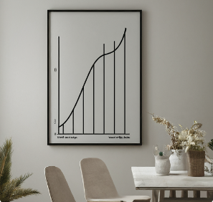
HUMAN-COMPUTER INTERFACE DESIGN
Benefits of HCI Design Generation
Increased Efficiency:
  Automates repetitive tasks, freeing up designers’ time for creative problem-solving.
Improved Design Quality:
Leverages AI analysis of user data for data-driven design decisions.
Democratization of Design:
Makes HCI design tools more accessible to a wider range of users.
Faster Design Iteration:
Allows for rapid prototyping and testing of different design concepts.
Date: May 20, 2024
Software Engineering Design: Theory and Practice

Slide 29

HUMAN-COMPUTER INTERFACE DESIGN
Challenges and Considerations
Limited Creativity:
  Current AI may struggle with tasks requiring high levels of creativity and conceptual design.
Bias in Data:
Design recommendations can be biased if the training data for the AI model is biased.
Over-reliance on Automation:
Human oversight and expertise remain crucial in the design process.
Ethical Considerations:
  Transparency and user privacy need to be addressed as AI plays a larger role in design.
Date: May 20, 2024
Software Engineering Design: Theory and Practice

Slide 30
HUMAN-COMPUTER INTERFACE DESIGN
HCI design Continuation
The term “HCI design continuation” is not a standard term within the field of Human-Computer Interaction (HCI) design. There are two possibilities:
“HCI design continuation” depending on the context:
  Possible Misunderstanding: It might be a mistake for a more common term like “HCI Design Iteration” (refining design based on feedback) or “HCI Design Evolution” (looking at the future of design with AI).
  Emphasis on Continuity: If it refers to existing design principles, it could mean maintaining a consistent visual style, interaction method, or user flow throughout the interface.
Date: May 20, 2024
Software Engineering Design: Theory and Practice

Slide 31
HUMAN-COMPUTER INTERFACE DESIGN
Visual Perception and Continuation
Our brains build connections between design elements based on laws of visual perception.
The human eye follows paths, lines, and curves, preferring a continuous flow of visual elements.
Continuation can be used to guide the eye through designs, establishing relationships between elements and directing attention.
Date: May 20, 2024
Software Engineering Design: Theory and Practice
Notes:
The field of HCI Design Generation is still in its early stages, but it holds immense promise for the future of HCI design. As AI and machine learning continue to evolve, we can expect to see even more sophisticated design generation tools emerge. The future of HCI design likely lies in a collaborative approach, where human designers and AI work together to leverage each other's strengths. AI can automate mundane tasks and analyze vast datasets, while human designers bring their creativity, empathy, and understanding of user needs to the table. Additionally, AI could play a more prominent role in user research and testing, automating tasks like data collection and analysis. Furthermore, the ability of AI to generate interactive prototypes would allow for more realistic user testing and improve the overall design evaluation process.

Slide 32
HUMAN-COMPUTER INTERFACE DESIGN
Importance of Continuation in HCI
Continuation is important for creating user-friendly, efficient, and intuitive user interfaces.
Continuation helps guide users along desired paths in the user interface.
Continuation has been a topic of interest in various HCI research areas like museum exhibition, mobile HCI, and game design.
Date: May 20, 2024
Software Engineering Design: Theory and Practice
Notes:
It's important to remember that HCI Design Generation is not intended to eliminate the human designer from the equation. Human designers play a crucial role in the design process, bringing their creativity, empathy, and understanding of user needs to the table. AI is best suited for automating repetitive tasks and analyzing data, freeing up designers to focus on the more strategic aspects of design. However, as AI design tools become more sophisticated, designers will need to develop new skills to work effectively with them. This may involve learning how to use these tools, interpret the data they generate, and effectively communicate design ideas to AI systems. In the future, designers may transition from creators of every design element to curators who select and orchestrate the design process using AI tools.

Slide 33
HUMAN-COMPUTER INTERFACE DESIGN
Applying Continuation in HCI Design
Understanding User Needs | Designing for Continuation
Developing a deep understanding of user needs and challenges is crucial for effective HCI design. Placing user needs and challenges at the center of the design process is important. | Arranging design elements on a line or curve can make them appear more related. Using continuation can help direct user attention and establish relationships between interface elements. Emerging technologies like AI may drive further evolution and innovation in HCI design.
Date: May 20, 2024
Software Engineering Design: Theory and Practice
Notes:
It's important to remember that HCI Design Generation is not intended to eliminate the human designer from the equation. Human designers play a crucial role in the design process, bringing their creativity, empathy, and understanding of user needs to the table. AI is best suited for automating repetitive tasks and analyzing data, freeing up designers to focus on the more strategic aspects of design. However, as AI design tools become more sophisticated, designers will need to develop new skills to work effectively with them. This may involve learning how to use these tools, interpret the data they generate, and effectively communicate design ideas to AI systems. In the future, designers may transition from creators of every design element to curators who select and orchestrate the design process using AI tools.

Slide 34
Conclusion
Continuation is a key principle in HCI design, influencing visual perception and user experience
Applying continuation effectively requires understanding user needs and challenges, and designing interfaces that guide users along desired paths
Continued research and innovation in HCI design, driven by emerging technologies, will likely further advance the use of continuation in user interfaces.
Date: May 20, 2024
Software Engineering Design: Theory and Practice

Slide 35
References
https://thedecisionlab.com/reference-guide/design/nielsens-heuristics
https://designftw.mit.edu/lectures/heuristic-eval/#error-prevention
https://www.youtube.com/watch?v=MdgBdrcMLQg
Date: May 20, 2024
Software Engineering Design: Theory and Practice

Slide 36
Thank You...
Mr. Ahsan Arif
Lecturer (Dept. of Software Engineering)
ahsanarif.se42@gmail.com

